Slide 1
Git and GitHub

Slide 2
Content
What is Version Control System?
What is Git?
Git Installation and Configuration
Git States/stages
What is GitHub?
Connecting Git with Github
Git Branching
Git merge and Rebase
Git Conflicts

Slide 3
Version Control System and Types
Version control is a system that records changes to a file or set of files over time so that you can recall specific versions later
Local Version Control Systems
Centralized Version Control Systems
Distributed Version Control Systems

Slide 4
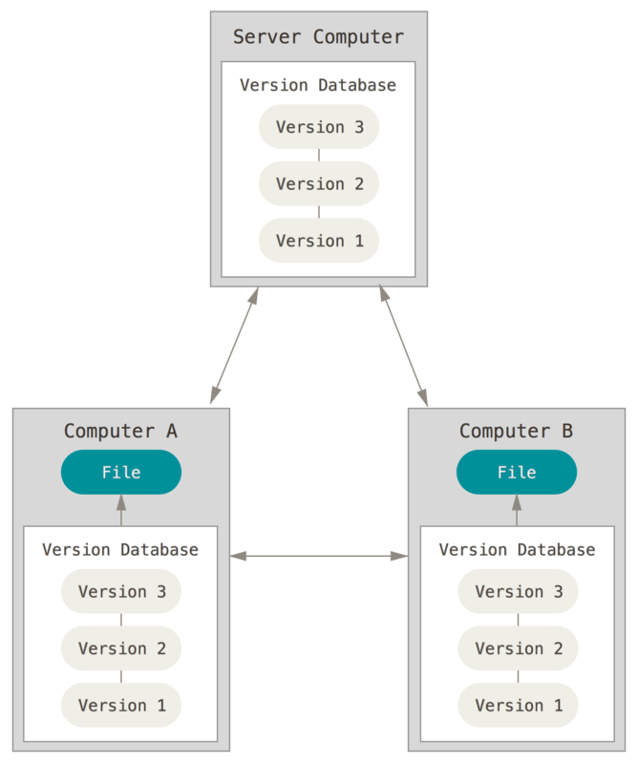

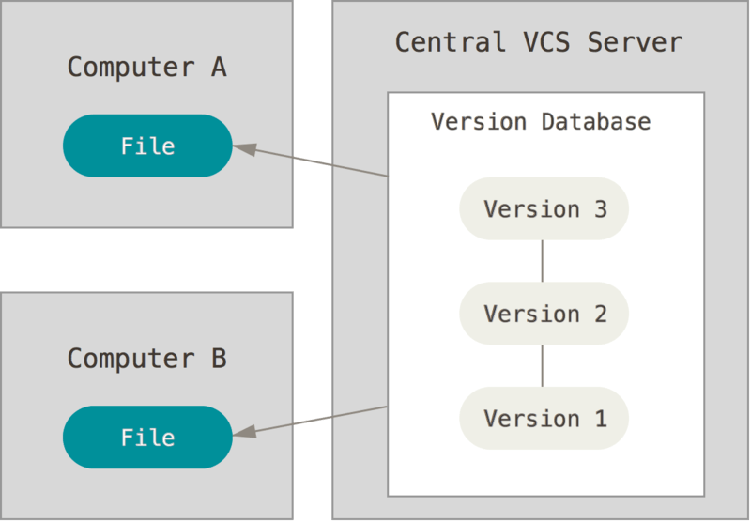
LVCS VS CVCS VS DVCS

Slide 5
Git Configuration && GitHub
$ git config --global user.name “Mallesh"
$ git config --global user.email “malleshdevops2021@gmail.com”
Github.com is a website that hosts git repositories on a remote server
Hosting repositories on Github facilitates the sharing of codebases among teams by providing a GUI to easily fork or clone repos to a local machine
Git States:
Git has three main states that your files can reside in: modified, staged, and committed:
Modified means that you have changed the file but have not committed it to your database yet.
Staged means that you have marked a modified file in its current version to go into your next commit snapshot.
Committed means that the data is safely stored in your local database.
This leads us to the three main sections of a Git project: the working tree, the staging area, and the Git directory.

Slide 6
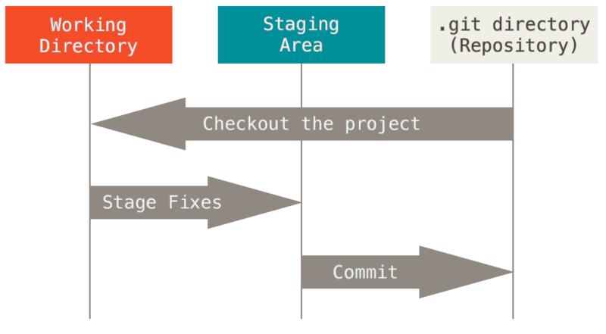
Git states/Stages
You modify files in your working tree.
2.You selectively stage just those changes you want to be part of your next commit, which adds only those changes to the staging area.
3.You do a commit, which takes the files as they are in the staging area and stores that snapshot permanently to your Git directory.

Slide 7
Connecting git with Github
The password option has been removed from Aug 2021.
Use the options like Token method and SSH authentication.
In order to prevent having to enter your password each time you push up to Github, you must configure git and Github to recognize Secured Shell (SSH) keys that you generate.
To check and see if you have any recognized SSH keys active on Github, go to https://github.com/settings/keys
If you do not see any SSH keys listed, you do not have SSH configured with Github.

Slide 8
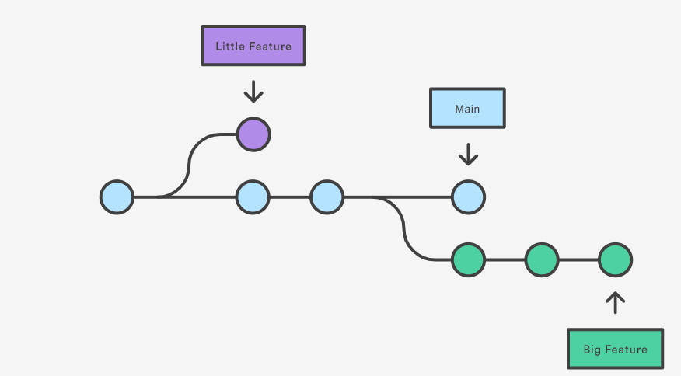
git branching
A branch in Git is simply a lightweight movable pointer to one of these commits. The default branch name in Git is master.
git branch to view current branches in repo
git checkout -b to create a new branch with branch name
git checkout without ‘-b’ flag to switch to existing Branche
git branch <branchname>
git switch <branchname>

Slide 9
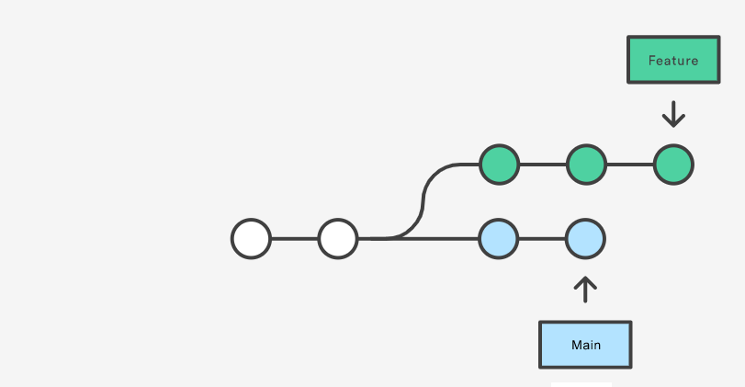
Merging vs Rebasing
From a conceptual standpoint, git merge and git rebase are used to achieve the same ultimate goal: to integrate changes from one branch into another branch. There are, however, distinct mechanics to both methods.
We will be discussing how to use each from the context of adding changes from your master branch into your current working feature branch

Slide 10
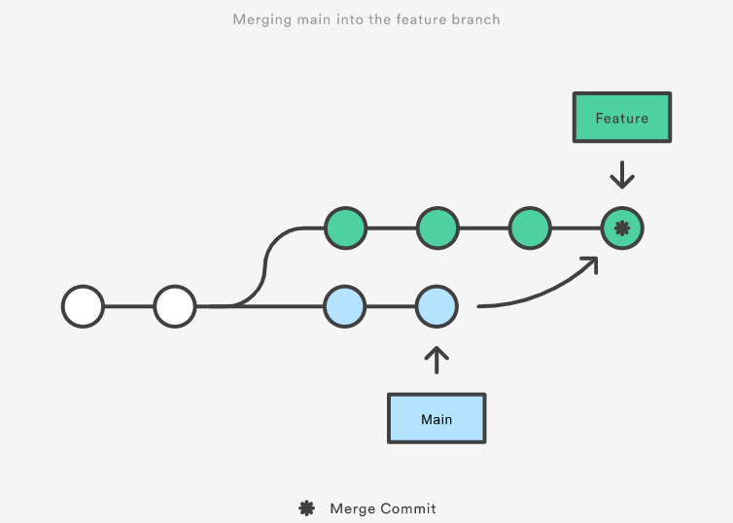
git merge: pros
Generally the easiest option to merge your master branch into your current working feature branch.
You can `git checkout feature` and then `git merge master` or you could just do it with one command: git merge feature master
By doing this, you create a new ‘merge commit’ in your feature branch, which is a non-destructive operation that ties the histories of both branches. This preserves the exact history of your project

Slide 11
git merge: cons
The branch that you merge will always have an extraneous merge commit that will be tracked every time you need to incorporate upstream states.
In other words, it essentially creates a forked history at the point where you merge.
This can lead to muddling the history of your branch, thereby making it more difficult for yourself or other developers to track the history of changes using `git log` and/or roll back to previous states.

Slide 12
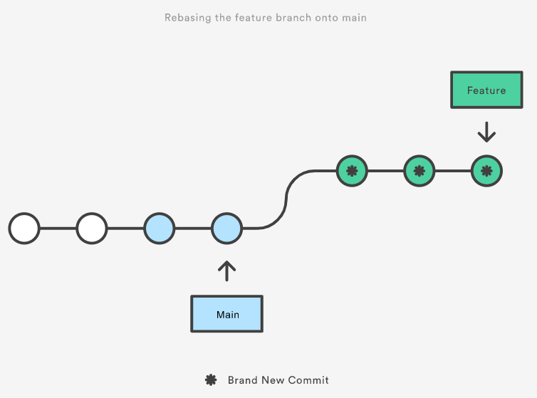
git rebase: pros
To rebase, you would `git checkout feature` and then `git rebase master`.
Instead of creating a merge commit, rebase will move the entire feature branch to start from the tip of the master branch by rewriting the project history and creating brand new commits for each commit in the original branch.
The result is a singular history with no forking of the commit history

Slide 13
git rebase: cons
Because rebase rewrites project history, you lose the context provided by a merge commit, i.e. you won’t be able to see when upstream changes were actually integrated into the feature branch.
More importantly, you could potentially cause extreme difficulty by rebasing master to the tip of your feature branch, leading git to think that your master branch’s history has diverged from the rest
In doing so, everyone else would still be working from the original master branch, and both masters would need to be merged together

Slide 14
Merge conflicts
Merge conflicts arise when two members of the same development team work on the same file and try to merge in their respective changes.
The proper way to avoid merge conflicts would be to ensure that only one branch is fully committed, pushed, and merged to master, allowing the other branch to integrate any changes before attempting to push and merge to master.
If merge conflicts arise, don’t fret! Many text editors (as well as Github) provide tools to help track down conflicts and resolve them. Often times, it will show incoming changes juxtaposed with the current state of your file, and allow you to choose which to keep (one or both)

